Slide 1
Machine Learning and React Native
@ray_deck

Slide 2
Functions Written by Machines

Slide 3
Supervised Learning Transfer Learning Reinforcement Learning Adversarial Networks

Slide 4
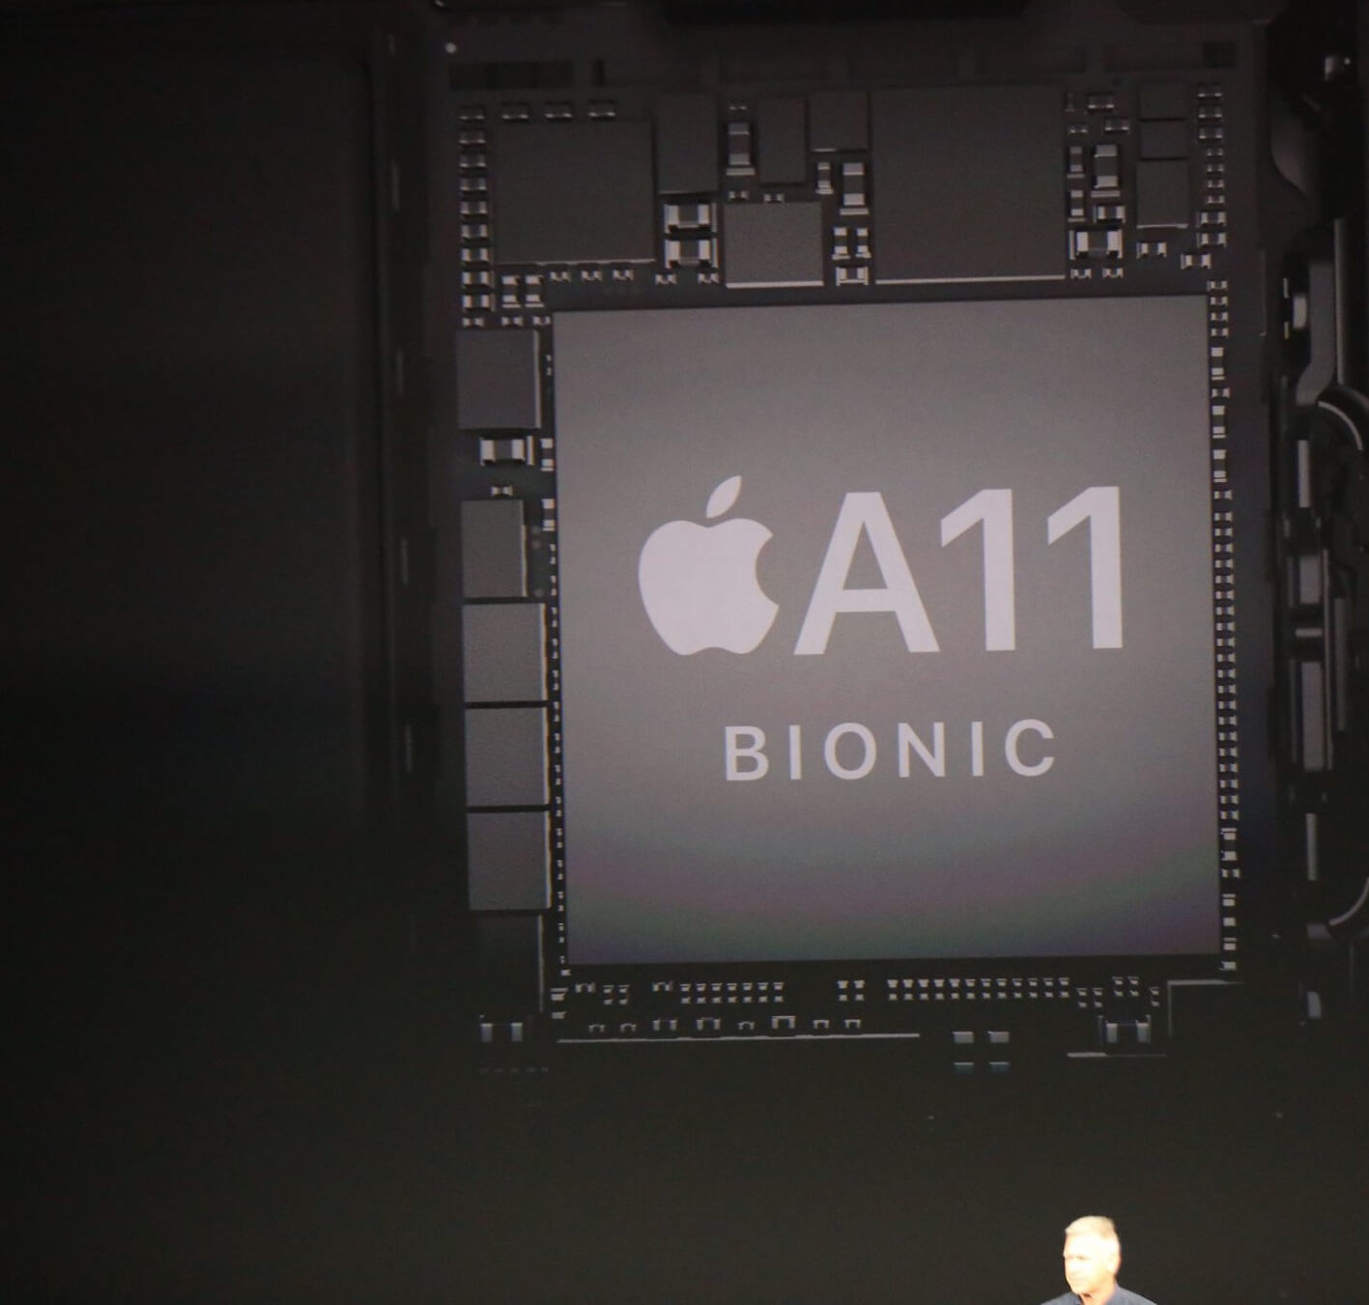
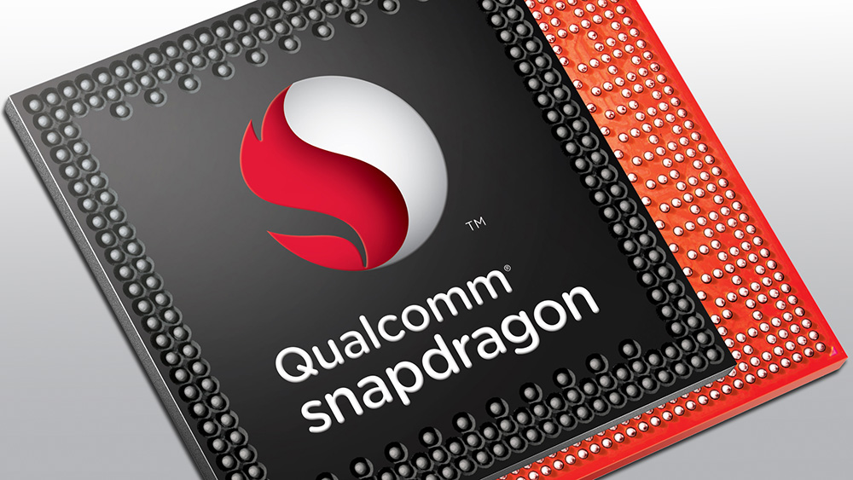

Slide 5
= f( )
0.1489
0.0026
0.0128
0.0731
0.1212
0.0933
0.0110
0.0011
0.0432
0.0002
0.0299
0.0054
0.0255
0.0035
0.1043
0.1407
0.0958
0.0060
0.0008
0.0417
0.0002
0.0389
0.3200 | 0.5421 | 0.5110 | 0.7389 | 0.4918 | 0.9184
0.8660 | 0.3020 | 0.4890 | 0.6987 | 0.3051 | 0.4029
0.0722 | 0.6375 | 0.7953 | 0.1546 | 0.2867 | 0.9654
0.3608 | 0.6891 | 0.8220 | 0.0024 | 0.2030 | 0.1865
0.6227 | 0.2532 | 0.9418 | 0.8587 | 0.0778 | 0.5965
0.1612 | 0.2107 | 0.1784 | 0.5981 | 0.5417 | 0.3071
0.2835 | 0.8236 | 0.3139 | 0.1868 | 0.7756 | 0.1203
0.5113 | 0.8758 | 0.0920 | 0.9075 | 0.1681 | 0.7669
0.6540 | 0.9847 | 0.2407 | 0.0232 | 0.4423 | 0.8521
0.1045 | 0.6293 | 0.9488 | 0.3950 | 0.5043 | 0.7875
0.0377 | 0.1511 | 0.6241 | 0.1502 | 0.2732 | 0.9331
0.2222 | 0.6622 | 0.5402 | 0.7650 | 0.1721 | 0.3517
0.4795 | 0.8597 | 0.4049 | 0.7070 | 0.0784 | 0.6631
0.3131 | 0.7966 | 0.4261 | 0.7823 | 0.7319 | 0.0807
0.2659 | 0.7687 | 0.7874 | 0.8179 | 0.0292 | 0.4352
0.4201 | 0.2091 | 0.2931 | 0.3404 | 0.4661 | 0.6139
0.3099 | 0.1022 | 0.0893 | 0.3600 | 0.8400 | 0.5494
0.0287 | 0.7979 | 0.6785 | 0.1231 | 0.0385 | 0.0082
0.5974 | 0.5917 | 0.1183 | 0.8901 | 0.9990 | 0.8012
0.7279 | 0.8426 | 0.2705 | 0.7502 | 0.9465 | 0.5517
0.9324 | 0.1228 | 0.4561 | 0.0281 | 0.7467 | 0.2544
0.9296 | 0.9581 | 0.9300 | 0.1107 | 0.0081 | 0.5787
0.0548 | 0.6564 | 0.0637 | 0.5374 | 0.1792 | 0.4786
0.3202 | 0.4883 | 0.9120 | 0.7424 | 0.8177 | 0.8120
0.8694 | 0.7283 | 0.8922 | 0.2756 | 0.9849 | 0.4665
0.2098 | 0.9957 | 0.5271 | 0.7638 | 0.4820 | 0.9617
0.2385 | 0.8299 | 0.3855 | 0.9500 | 0.3676 | 0.2845
0.1923 | 0.7167 | 0.6323 | 0.9345 | 0.2605 | 0.0331
0.5322 | 0.1652 | 0.4930 | 0.2563 | 0.5717 | 0.1103
0.7212 | 0.4764 | 0.9196 | 0.6196 | 0.4345 | 0.6993
0.8939 | 0.5753 | 0.7510 | 0.1955 | 0.7078 | 0.9869
0.9766 | 0.7216 | 0.0188 | 0.8569 | 0.8033 | 0.7709
0.3885 | 0.6761 | 0.4612 | 0.8000 | 0.8435 | 0.8812

Slide 6
y = f(x)

Slide 7
Computer Vision Image Classification Natural Language Processing

Slide 8
Who is here? What am I looking at? How do you feel?

Slide 9
Context

Slide 10


Slide 11
Privacy Performance Personalization

Slide 12
File Specification Runtime

Slide 13
Code as Asset

Slide 14
Context

Slide 15
Reality is Declarative

Slide 16
Machine Learning Makes the World Your Provider

Slide 17
<WorldProvider faceClassifier={modelPath}> … <WorldConsumer> {({people})=>{ return people.map(face=>{ return (<PersonProvider person={face}>… }) }} </WorldConsumer> </WorldProvider>

Slide 18
react-native-tesseract-ocr react-native-coreml react-native-vision

Slide 19
Make the World Your Provider

Slide 20
Thank You
github.com/rhdeck/chainreact-2018

Slide 23
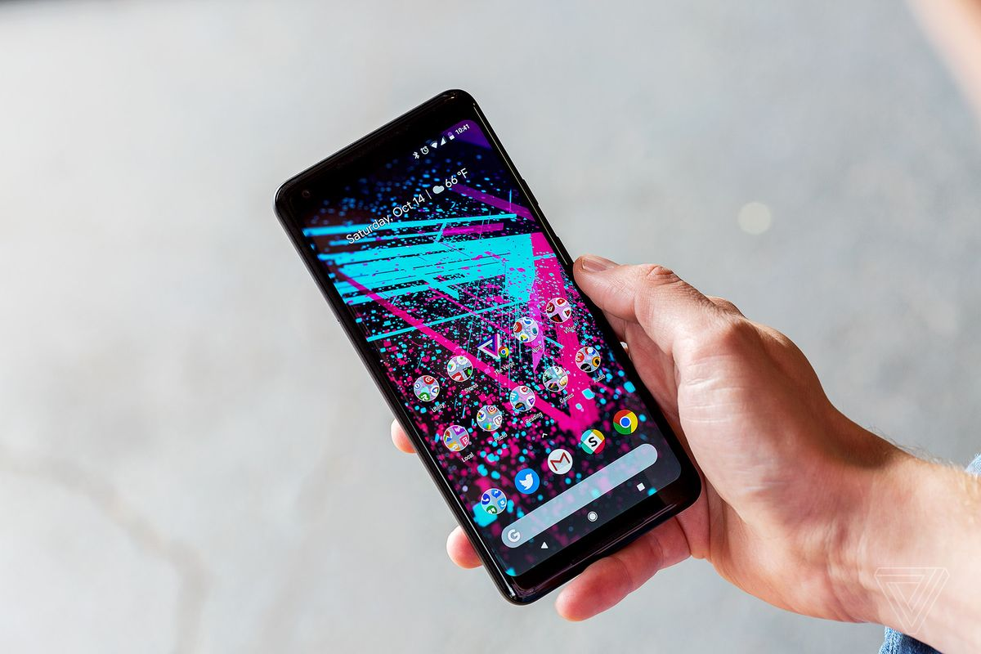
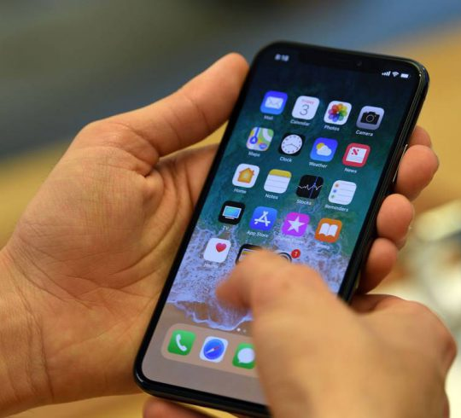

Slide 24
JavaScriptCore

Slide 25
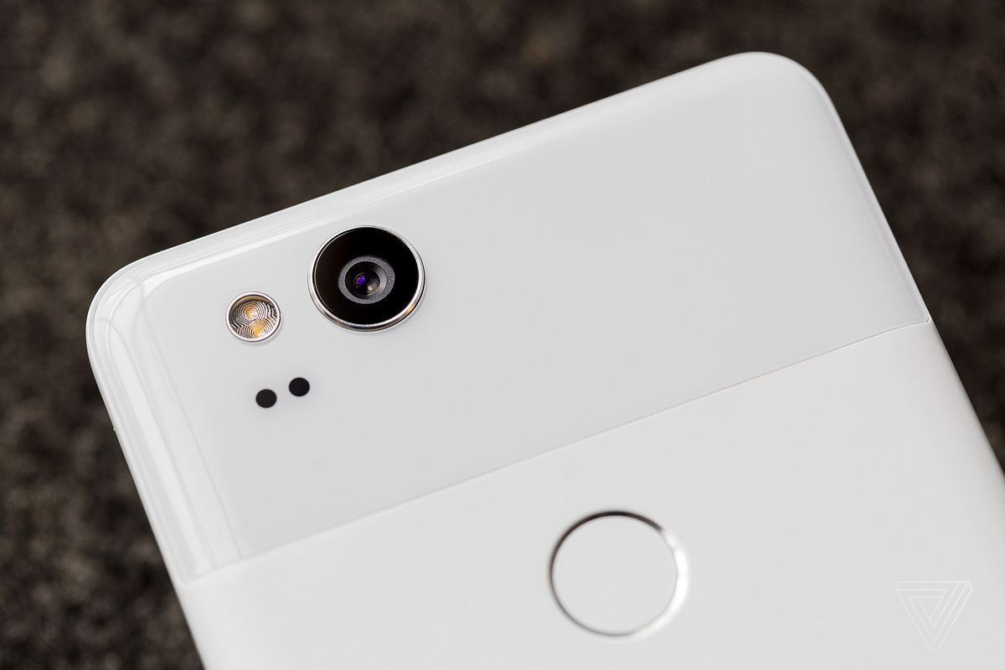
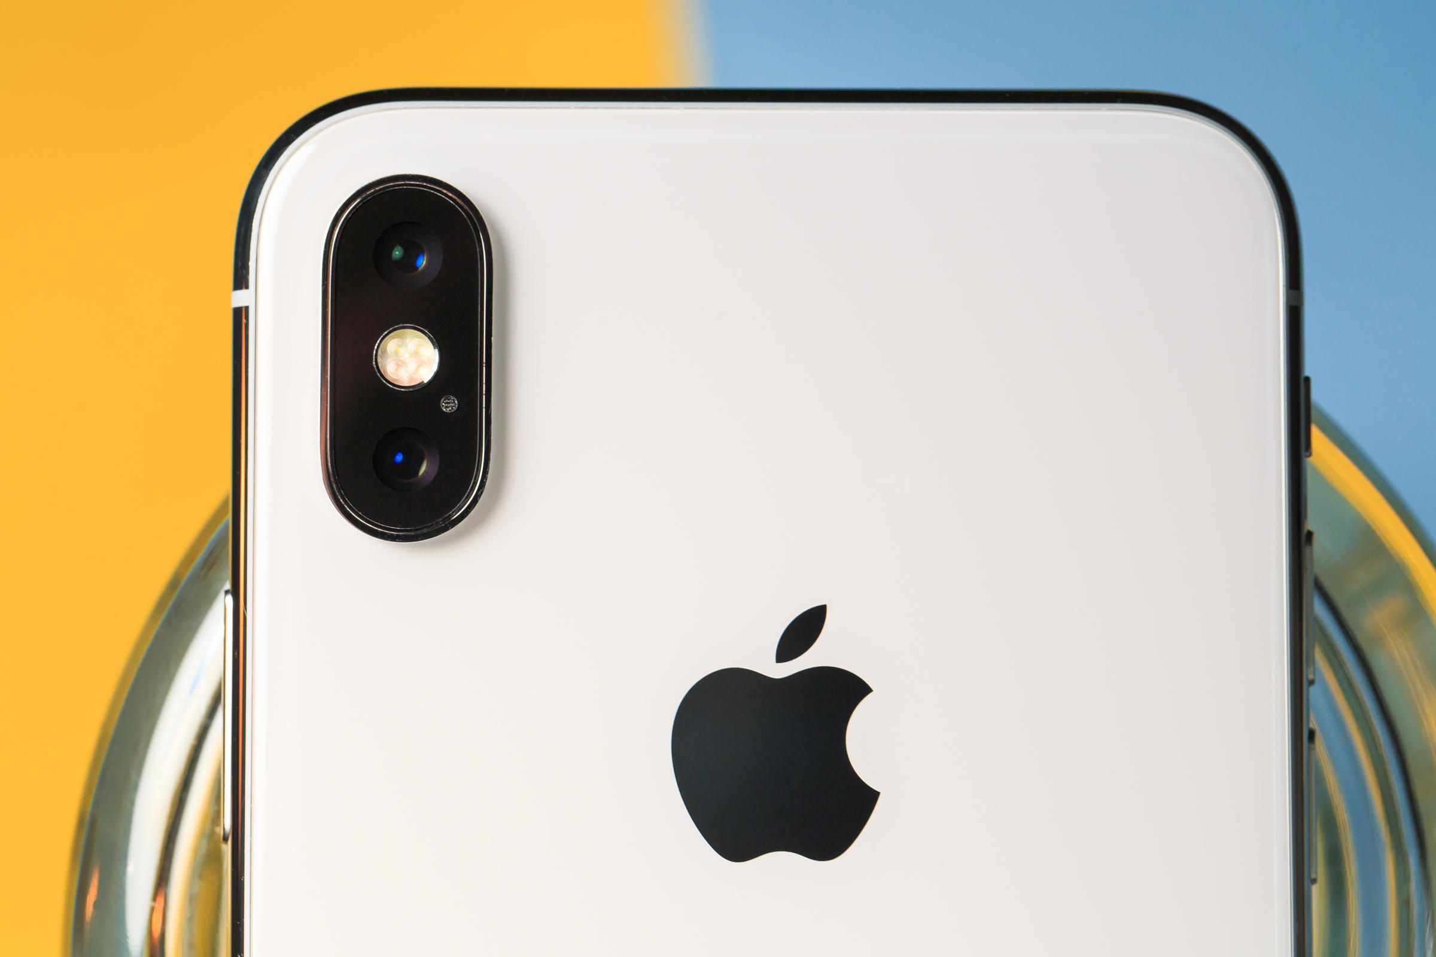

Slide 26


VisionKit Vision
Tesseract OCR

Slide 27
ML and React Native
@ray_deck

Slide 28
CoreML TF Lite
Caffe2

Slide 30
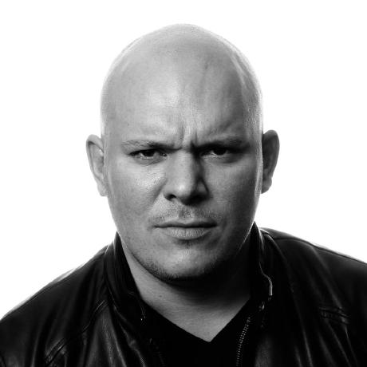
0.3200 | 0.5421 | 0.5110 | 0.7389 | 0.4918 | 0.9184
0.8660 | 0.3020 | 0.4890 | 0.6987 | 0.3051 | 0.4029
0.0722 | 0.6375 | 0.7953 | 0.1546 | 0.2867 | 0.9654
0.3608 | 0.6891 | 0.8220 | 0.0024 | 0.2030 | 0.1865
0.6227 | 0.2532 | 0.9418 | 0.8587 | 0.0778 | 0.5965
0.1612 | 0.2107 | 0.1784 | 0.5981 | 0.5417 | 0.3071
0.2835 | 0.8236 | 0.3139 | 0.1868 | 0.7756 | 0.1203
0.5113 | 0.8758 | 0.0920 | 0.9075 | 0.1681 | 0.7669
0.6540 | 0.9847 | 0.2407 | 0.0232 | 0.4423 | 0.8521
0.1045 | 0.6293 | 0.9488 | 0.3950 | 0.5043 | 0.7875
0.0377 | 0.1511 | 0.6241 | 0.1502 | 0.2732 | 0.9331
0.2222 | 0.6622 | 0.5402 | 0.7650 | 0.1721 | 0.3517
0.4795 | 0.8597 | 0.4049 | 0.7070 | 0.0784 | 0.6631
0.3131 | 0.7966 | 0.4261 | 0.7823 | 0.7319 | 0.0807
0.2659 | 0.7687 | 0.7874 | 0.8179 | 0.0292 | 0.4352
0.4201 | 0.2091 | 0.2931 | 0.3404 | 0.4661 | 0.6139
0.3099 | 0.1022 | 0.0893 | 0.3600 | 0.8400 | 0.5494
0.0287 | 0.7979 | 0.6785 | 0.1231 | 0.0385 | 0.0082
0.5974 | 0.5917 | 0.1183 | 0.8901 | 0.9990 | 0.8012
0.7279 | 0.8426 | 0.2705 | 0.7502 | 0.9465 | 0.5517
0.9324 | 0.1228 | 0.4561 | 0.0281 | 0.7467 | 0.2544
0.9296 | 0.9581 | 0.9300 | 0.1107 | 0.0081 | 0.5787
0.0548 | 0.6564 | 0.0637 | 0.5374 | 0.1792 | 0.4786
0.3202 | 0.4883 | 0.9120 | 0.7424 | 0.8177 | 0.8120
0.8694 | 0.7283 | 0.8922 | 0.2756 | 0.9849 | 0.4665
0.2098 | 0.9957 | 0.5271 | 0.7638 | 0.4820 | 0.9617
0.2385 | 0.8299 | 0.3855 | 0.9500 | 0.3676 | 0.2845
0.1923 | 0.7167 | 0.6323 | 0.9345 | 0.2605 | 0.0331
0.5322 | 0.1652 | 0.4930 | 0.2563 | 0.5717 | 0.1103
0.7212 | 0.4764 | 0.9196 | 0.6196 | 0.4345 | 0.6993
0.8939 | 0.5753 | 0.7510 | 0.1955 | 0.7078 | 0.9869
0.9766 | 0.7216 | 0.0188 | 0.8569 | 0.8033 | 0.7709
0.3885 | 0.6761 | 0.4612 | 0.8000 | 0.8435 | 0.8812

Slide 31
Local AI with CoreML and TensorFlow Lite - and More!
@ray_deck

Slide 33
Artificial Intelligence Statistical Computing Machine Learning Stochastic Programming

Slide 35
0.3200 | 0.5421 | 0.5110 | 0.7389 | 0.4918 | 0.9184
0.8660 | 0.3020 | 0.4890 | 0.6987 | 0.3051 | 0.4029
0.0722 | 0.6375 | 0.7953 | 0.1546 | 0.2867 | 0.9654
0.3608 | 0.6891 | 0.8220 | 0.0024 | 0.2030 | 0.1865
0.6227 | 0.2532 | 0.9418 | 0.8587 | 0.0778 | 0.5965
0.1612 | 0.2107 | 0.1784 | 0.5981 | 0.5417 | 0.3071
0.2835 | 0.8236 | 0.3139 | 0.1868 | 0.7756 | 0.1203
0.5113 | 0.8758 | 0.0920 | 0.9075 | 0.1681 | 0.7669
0.6540 | 0.9847 | 0.2407 | 0.0232 | 0.4423 | 0.8521
0.1045 | 0.6293 | 0.9488 | 0.3950 | 0.5043 | 0.7875
0.0377 | 0.1511 | 0.6241 | 0.1502 | 0.2732 | 0.9331
’Murica!
0.2222 | 0.6622 | 0.5402 | 0.7650 | 0.1721 | 0.3517
0.4795 | 0.8597 | 0.4049 | 0.7070 | 0.0784 | 0.6631
0.3131 | 0.7966 | 0.4261 | 0.7823 | 0.7319 | 0.0807
0.2659 | 0.7687 | 0.7874 | 0.8179 | 0.0292 | 0.4352
0.4201 | 0.2091 | 0.2931 | 0.3404 | 0.4661 | 0.6139
0.3099 | 0.1022 | 0.0893 | 0.3600 | 0.8400 | 0.5494
0.0287 | 0.7979 | 0.6785 | 0.1231 | 0.0385 | 0.0082
0.5974 | 0.5917 | 0.1183 | 0.8901 | 0.9990 | 0.8012
0.7279 | 0.8426 | 0.2705 | 0.7502 | 0.9465 | 0.5517
0.9324 | 0.1228 | 0.4561 | 0.0281 | 0.7467 | 0.2544
0.9296 | 0.9581 | 0.9300 | 0.1107 | 0.0081 | 0.5787
0.0548 | 0.6564 | 0.0637 | 0.5374 | 0.1792 | 0.4786
0.3202 | 0.4883 | 0.9120 | 0.7424 | 0.8177 | 0.8120
0.8694 | 0.7283 | 0.8922 | 0.2756 | 0.9849 | 0.4665
0.2098 | 0.9957 | 0.5271 | 0.7638 | 0.4820 | 0.9617
0.2385 | 0.8299 | 0.3855 | 0.9500 | 0.3676 | 0.2845
0.1923 | 0.7167 | 0.6323 | 0.9345 | 0.2605 | 0.0331
0.5322 | 0.1652 | 0.4930 | 0.2563 | 0.5717 | 0.1103
0.7212 | 0.4764 | 0.9196 | 0.6196 | 0.4345 | 0.6993
0.8939 | 0.5753 | 0.7510 | 0.1955 | 0.7078 | 0.9869
0.9766 | 0.7216 | 0.0188 | 0.8569 | 0.8033 | 0.7709
0.3885 | 0.6761 | 0.4612 | 0.8000 | 0.8435 | 0.8812

Slide 36
= f( )
65% | Ken Wheeler
12% | ‘Murica

Slide 37
Conv2D MaxPool ReLU Sigmoid TanH LSTM GRU

Slide 38
Data
Training
Packaging
Inference
Application

Slide 39
Inference

Slide 40


Slide 41
Models Written by Machines

Slide 43

0.3200 | 0.5421 | 0.5110 | 0.7389 | 0.4918 | 0.9184
0.8660 | 0.3020 | 0.4890 | 0.6987 | 0.3051 | 0.4029
0.0722 | 0.6375 | 0.7953 | 0.1546 | 0.2867 | 0.9654
0.3608 | 0.6891 | 0.8220 | 0.0024 | 0.2030 | 0.1865
0.6227 | 0.2532 | 0.9418 | 0.8587 | 0.0778 | 0.5965
0.1612 | 0.2107 | 0.1784 | 0.5981 | 0.5417 | 0.3071
0.2835 | 0.8236 | 0.3139 | 0.1868 | 0.7756 | 0.1203
0.5113 | 0.8758 | 0.0920 | 0.9075 | 0.1681 | 0.7669
0.6540 | 0.9847 | 0.2407 | 0.0232 | 0.4423 | 0.8521
0.1045 | 0.6293 | 0.9488 | 0.3950 | 0.5043 | 0.7875
0.0377 | 0.1511 | 0.6241 | 0.1502 | 0.2732 | 0.9331
0.2222 | 0.6622 | 0.5402 | 0.7650 | 0.1721 | 0.3517
0.4795 | 0.8597 | 0.4049 | 0.7070 | 0.0784 | 0.6631
0.3131 | 0.7966 | 0.4261 | 0.7823 | 0.7319 | 0.0807
0.2659 | 0.7687 | 0.7874 | 0.8179 | 0.0292 | 0.4352
0.4201 | 0.2091 | 0.2931 | 0.3404 | 0.4661 | 0.6139
0.3099 | 0.1022 | 0.0893 | 0.3600 | 0.8400 | 0.5494
0.0287 | 0.7979 | 0.6785 | 0.1231 | 0.0385 | 0.0082
0.5974 | 0.5917 | 0.1183 | 0.8901 | 0.9990 | 0.8012
0.7279 | 0.8426 | 0.2705 | 0.7502 | 0.9465 | 0.5517
0.9324 | 0.1228 | 0.4561 | 0.0281 | 0.7467 | 0.2544
0.9296 | 0.9581 | 0.9300 | 0.1107 | 0.0081 | 0.5787
0.0548 | 0.6564 | 0.0637 | 0.5374 | 0.1792 | 0.4786
0.3202 | 0.4883 | 0.9120 | 0.7424 | 0.8177 | 0.8120
0.8694 | 0.7283 | 0.8922 | 0.2756 | 0.9849 | 0.4665
0.2098 | 0.9957 | 0.5271 | 0.7638 | 0.4820 | 0.9617
0.2385 | 0.8299 | 0.3855 | 0.9500 | 0.3676 | 0.2845
0.1923 | 0.7167 | 0.6323 | 0.9345 | 0.2605 | 0.0331
0.5322 | 0.1652 | 0.4930 | 0.2563 | 0.5717 | 0.1103
0.7212 | 0.4764 | 0.9196 | 0.6196 | 0.4345 | 0.6993
0.8939 | 0.5753 | 0.7510 | 0.1955 | 0.7078 | 0.9869
0.9766 | 0.7216 | 0.0188 | 0.8569 | 0.8033 | 0.7709
0.3885 | 0.6761 | 0.4612 | 0.8000 | 0.8435 | 0.8812

Slide 44
Small Giants

Slide 45
Local Intelligence
@ray_deck

Slide 46
Wadsworth Constant

Slide 47
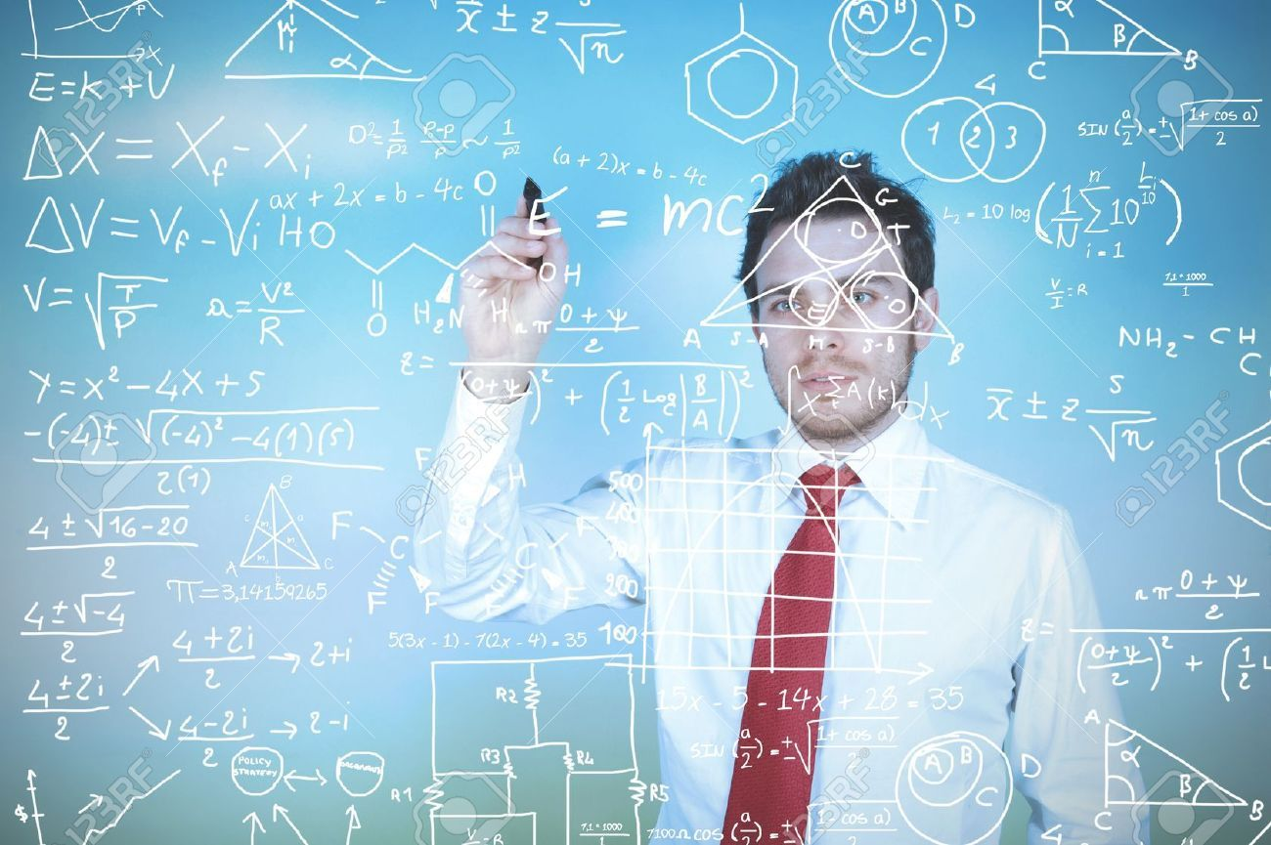

Slide 48
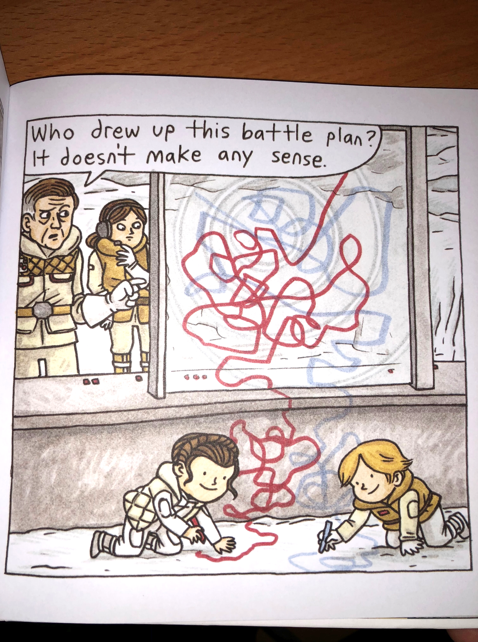

Slide 49
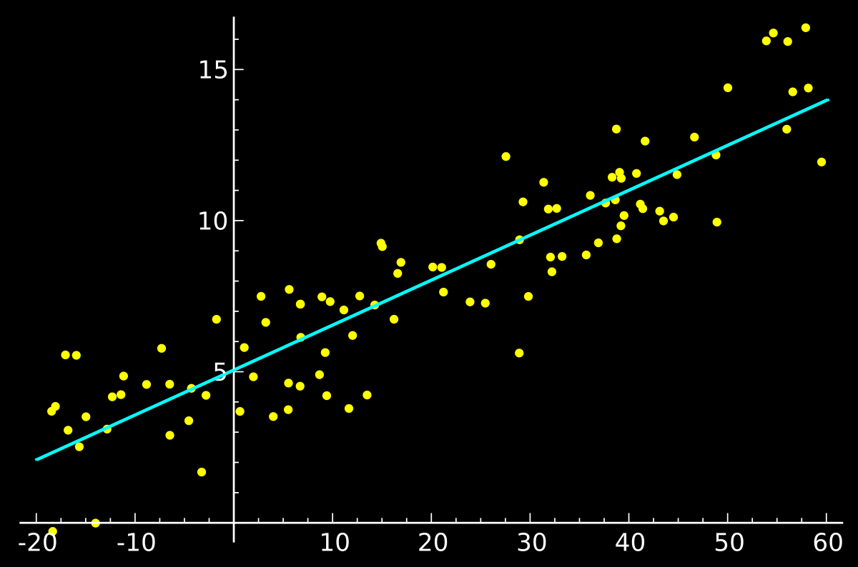
y = mx + b

Slide 50
Differentiation

Slide 51
High-Dimensional Numbers

Slide 52
High-Dimensional Vectors

Slide 53
High-Dimensional Arrays

Slide 54
0.3200 | 0.5421 | 0.5110 | 0.7389 | 0.4918 | 0.9184
0.8660 | 0.3020 | 0.4890 | 0.6987 | 0.3051 | 0.4029
0.0722 | 0.6375 | 0.7953 | 0.1546 | 0.2867 | 0.9654
0.3608 | 0.6891 | 0.8220 | 0.0024 | 0.2030 | 0.1865
0.6227 | 0.2532 | 0.9418 | 0.8587 | 0.0778 | 0.5965
0.1612 | 0.2107 | 0.1784 | 0.5981 | 0.5417 | 0.3071
0.2835 | 0.8236 | 0.3139 | 0.1868 | 0.7756 | 0.1203
0.5113 | 0.8758 | 0.0920 | 0.9075 | 0.1681 | 0.7669
0.6540 | 0.9847 | 0.2407 | 0.0232 | 0.4423 | 0.8521
0.1045 | 0.6293 | 0.9488 | 0.3950 | 0.5043 | 0.7875
0.0377 | 0.1511 | 0.6241 | 0.1502 | 0.2732 | 0.9331
0.2222 | 0.6622 | 0.5402 | 0.7650 | 0.1721 | 0.3517
0.4795 | 0.8597 | 0.4049 | 0.7070 | 0.0784 | 0.6631
0.3131 | 0.7966 | 0.4261 | 0.7823 | 0.7319 | 0.0807
0.2659 | 0.7687 | 0.7874 | 0.8179 | 0.0292 | 0.4352
0.4201 | 0.2091 | 0.2931 | 0.3404 | 0.4661 | 0.6139
0.3099 | 0.1022 | 0.0893 | 0.3600 | 0.8400 | 0.5494
0.0287 | 0.7979 | 0.6785 | 0.1231 | 0.0385 | 0.0082
0.5974 | 0.5917 | 0.1183 | 0.8901 | 0.9990 | 0.8012
0.7279 | 0.8426 | 0.2705 | 0.7502 | 0.9465 | 0.5517
0.9324 | 0.1228 | 0.4561 | 0.0281 | 0.7467 | 0.2544
0.9296 | 0.9581 | 0.9300 | 0.1107 | 0.0081 | 0.5787
0.0548 | 0.6564 | 0.0637 | 0.5374 | 0.1792 | 0.4786
0.3202 | 0.4883 | 0.9120 | 0.7424 | 0.8177 | 0.8120
0.8694 | 0.7283 | 0.8922 | 0.2756 | 0.9849 | 0.4665
0.2098 | 0.9957 | 0.5271 | 0.7638 | 0.4820 | 0.9617
0.2385 | 0.8299 | 0.3855 | 0.9500 | 0.3676 | 0.2845
0.1923 | 0.7167 | 0.6323 | 0.9345 | 0.2605 | 0.0331
0.5322 | 0.1652 | 0.4930 | 0.2563 | 0.5717 | 0.1103
0.7212 | 0.4764 | 0.9196 | 0.6196 | 0.4345 | 0.6993
0.8939 | 0.5753 | 0.7510 | 0.1955 | 0.7078 | 0.9869
0.9766 | 0.7216 | 0.0188 | 0.8569 | 0.8033 | 0.7709
0.3885 | 0.6761 | 0.4612 | 0.8000 | 0.8435 | 0.8812

Slide 55
0.1489
0.0026
0.0128
0.0731
0.1212
0.0933
0.0110
0.0011
0.0432
0.0002
0.0299
0.0054
0.0255
0.0035
0.1043
0.1407
0.0958
0.0060
0.0008
0.0417
0.0002
0.0389
35% | SwiftFest Logo
24% | Swift Logo
12% | Bird

Slide 56
Conv2D MaxPool ReLU Sigmoid TanH LSTM GRU

Slide 57

Code
Caffe
Data
2013

Slide 59
Code
Caffe
Data
2012
2015

Slide 60
Model as Data Structure Model as Code

Slide 61
Automatic Differentiation

Slide 62

Code
Caffe
Data
2012
2015
2016

Slide 63

Code
Caffe
Data
2012
2015
2016

Slide 64


Slide 65
File Specification API Conversion Tools

Slide 66
ProtoBuf
apple.github.io/coremltools/coremlspecification

Slide 67
Feature Engineering

Slide 68

Input Conversion
Execution
Metal
Output Conversion
35% | SwiftFest Logo
24% | Swift Logo
12% | Bird

Slide 69
MLModel VisionKit NSLinguisticTagger GameplayKit

Slide 70
VNRequest

Slide 71
VNCoreMLRequest

Slide 72
VNClassificationObservation

Slide 73
MLModel.compile(url:)

Slide 74
DictionaryFeatureProvider

Slide 75
let c = MLModel.compile(url: u)
let m = MLModel(url: c)
let d:[String:Any] = [“input”: image]
let dfpin = MLDictionaryFeatureProvider(dictionary: d)
let fp = m.predict(dfp)
let dfpout = fp.featureValue(for: “labels”)
let dic = dfpout.dictionaryValue
let topResult = dic.first()

Slide 76
MLMultiArray

Slide 77
Input Conversion
Execution
Metal
MLMultiArray

Slide 78
MLMultiArray
Execution
Metal
Output Conversion
35% | SwiftFest Logo
24% | Swift Logo
12% | Bird

Slide 79
let m = MLModel(url: c)
let d:[String:Any] = [“input”: image]
let dfpin = MLDictionaryFeatureProvider(dictionary: d)
let fp = m.predict(dfp)
let c2 = MLModel.compile(url: u2)
let m2 = MLModel(url: c2)
let fp2 = m2.predict(fp)
let dfpout = fp2.featureValue(for: “labels”)
let dic = dfpout.dictionaryValue
let topResult = dic.first()

Slide 80
Bottlenecking

Slide 81
Composition

Slide 82
Packaging

Slide 83
Code
Caffe
Data
Time

Slide 84
Python
Bindings
C Runtime

Slide 85
Object-Oriented Interpreted

Slide 86


Slide 87
Python
Compiler & Runtime
Bindings
C Runtime

Slide 88
import Python
let np = Python.import("numpy")
let gzip = Python.import("gzip")

Slide 89
Automatic Differentiation

Slide 90
@differentiable

Slide 91
@differentiable(reverse, adjoint: dTanh)
func tanh(_ x: Float) -> Float {
// ... some super low-level assembly…}
func dTanh(x: Float, y: Float, seed: Float) -> Float {
return (1.0 - (y * y)) * seed
}
// Get the gradient function of tanh.
let dtanh_dx = #gradient(of: tanh)
dtanh_dx(2)

Slide 92
// Get the gradient function of foo with respect to the first parameter.
let dfoo_dx = #gradient(of: foo, withRespectTo: .0)
dfoo_dx(3, 4)

Slide 93
Eager Execution

Slide 94
Composition

Slide 95



Code
Caffe
Data
Time

Slide 98
Thank You
github.com/rhdeck/swiftfest-2018

